Slide 1
Extract the data through ECC system
Milind Parab

Slide 2
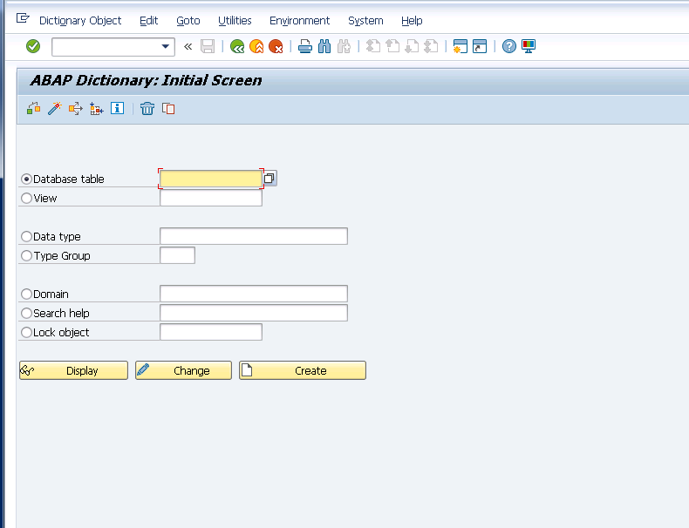
Logic to SAP and enter T-code “SE11”

Slide 3
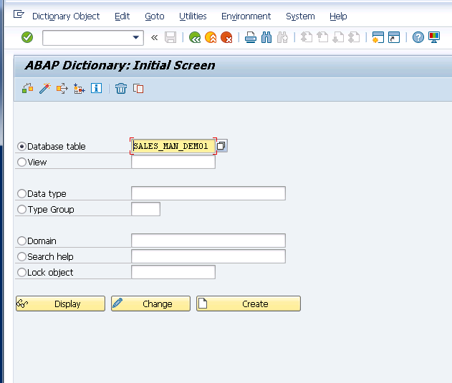
Create database “SALES_MAN_DEMO1”

